Slide 1
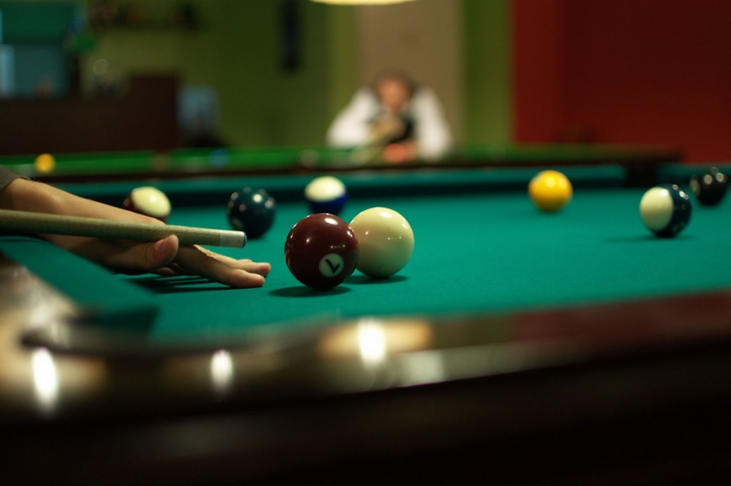
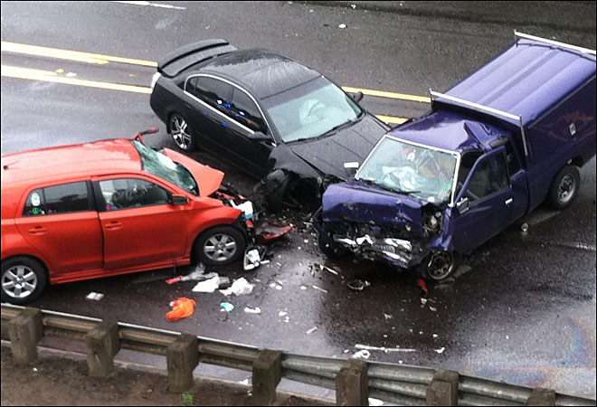
Newtons Laws

Slide 2
Newtons First Law
An object at rest stays at rest and an object in motion stays in motion with the same speed and in the same direction unless acted upon by an unbalanced force.

Slide 3
Thought Experiment!
Suppose that you filled a baking dish to the rim with water and walked around an oval track making an attempt to complete a lap in the least amount of time. The water would have a tendency to spill from the container during specific locations on the track. In general the water spilled when:

Slide 4
the container was at rest and you attempted to move it
the container was in motion and you attempted to stop it
the container was moving in one direction and you attempted to change its direction.
The water spills whenever the state of motion of the container is changed. The water tended to "keep on doing what it was doing."

Slide 5
Inertia
Inertia is the tendency of an object to resist changes in its state of motion.
But what is meant by it’s state of motion?
The state of motion of an object is defined by its velocity . Thus inertia can be redefined as:
Inertia: tendency of an object to resist changes in its velocity.
Remember a change in velocity is an acceleration (ie it resists acceleration)

Slide 6
Question
A 4.0 kg object is moving across a frictionless surface at 2 m/s. Which one of the following horizontal forces is necessary to maintain this state of motion?
0 N
0.5 N
2.0 N
8.0 N
Depends on the speed

Slide 7
Inertia Continued
Do some objects have more of a tendency to resist changes in their state of motion than others?
YES. The tendency of an object to resist changes in its state of motion varies with mass.
A more massive object has a greater tendency to resist changes in its state of motion.

Slide 8
Question
Suppose that there are two seemingly identical bricks at rest on the physics lecture table. Yet one brick consists of mortar and the other brick consists of Styrofoam. Without lifting the bricks, how could you tell which brick was the Styrofoam brick?

Slide 9
You could give the bricks an identical push in an effort to change their state of motion. The brick that offers the least resistance is the brick with the least inertia - and therefore the brick with the least mass

Slide 10
Other Examples of Newtons First Law
Blood rushes from your head to your feet while quickly stopping when riding on a descending elevator.
The head of a hammer can be tightened onto the wooden handle by banging the bottom of the handle against a hard surface.
Headrests are placed in cars to prevent whiplash injuries during rear-end collisions.

Slide 11
What is an unbalanced force?
An object is said to be acted upon by an unbalanced force only when there is an individual force that is not being balanced by a force of equal magnitude and in the opposite direction

Slide 12
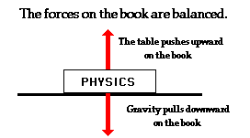
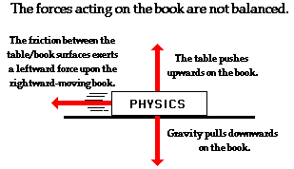

Slide 13
Other Examples
Satellites
Car turning around a bend in the road
Remember – velocity is a vector and thus has magnitude and direction. If an object maintains constant speed but has a changing direction then IT IS accelerating.

Slide 14
Force
A force is a push or pull upon an object resulting from the object's interaction with another object.
Whenever there is an interaction between two objects, there is a force upon each of the objects. When the interaction ceases, the two objects no longer experience the force.
Forces only exist as a result of an interaction.

Slide 15
Types of Forces
Contact forces are those types of forces that result when the two interacting objects are perceived to be physically contacting each other. Examples of contact forces include frictional forces, tensional forces, normal forces, air resistance forces, and applied forces.

Slide 16
Action-at-a-distance forces are those types of forces that result even when the two interacting objects are not in physical contact with each other, yet are able to exert a push or pull despite their physical separation. Examples of action-at-a-distance forces include gravitational forces, electrical forces, and magnetic forces.

Slide 17
Newton's Second Law
The acceleration of an object as produced by a net force is directly proportional to the magnitude of the net force, in the same direction as the net force, and inversely proportional to the mass of the object.
OR a = F_{net} / m
Rearraged commonly as F_{net} = m a

Slide 18
F ∝ m
More mass requires more force to change speed
F ∝ a
More force means more acceleration
m ∝ 1/a
More mass means there is less acceleration per unit of force (car demonstration)

Slide 19
How is force Measured?
1 Newton = 1 kg • m/s²
One Newton is defined as the amount of force required to give a 1-kg mass an acceleration of 1 m/s²

Slide 20
Force due to Gravity
F = ma
Acceleration due to gravity is “g” or 9.8 m/s²
Therefore F = mg, which is also known as Weight

Slide 21
Force of friction
Always opposes the direction of movement
Air resistance is a type of friction

Slide 22
Force diagram
An object being pushed on a table with a force of 20 N experiences a frictional force of 10 N.
A free falling object has a weight of 50 N and experiences an air resistance of 20 N.

Slide 23
Net Force
A free falling object weighing 80kg experiences an air resistance of 600 Newtons (N). What is the net force on the object? How fast does it accelerate?
Remember that a net force will cause an acceleration

Slide 24
Newton's Third Law
For every action, there is an equal and opposite reaction.

Slide 25
Explanation
The statement means that in every interaction, there is a pair of forces acting on the two interacting objects. The size of the forces on the first object equals the size of the force on the second object. The direction of the force on the first object is opposite to the direction of the force on the second object. Forces always come in pairs - equal and opposite action-reaction force pairs.

Slide 26
Ex) The normal force
A book is placed on a table. What forces are acting on it?

Slide 27
Other examples
Birds flying
Wings push air down, the air reacts by pushing the bird up.
Bug on a windshield
Forces are the same but because of the small mass of the bug it can’t withstand the greater acceleration, so the bug splatters.

Slide 28
Other examples
A gun recoiling
The bullet pushes the gun back, while the gun pushes the bullet forward.
Which has a bigger force ? Which has a bigger acceleration ?

Slide 29
Question
For years, space travel was believed to be impossible because there was nothing that rockets could push off of in space in order to provide the propulsion necessary to accelerate. This inability of a rocket to provide propulsion is because ...
a. ... space is void of air so the rockets have nothing to push off of.
b. ... gravity is absent in space.
c. ... space is void of air and so there is no air resistance in space.
d. ... nonsense! Rockets do accelerate in space and have been able to do so for a long time.

